Slide 1
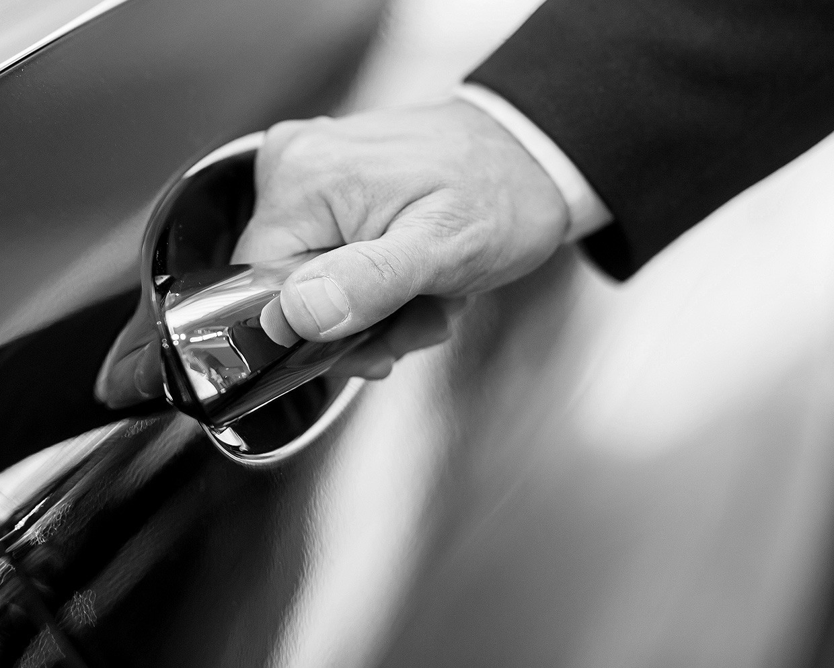
LET YOUR CAR STAY WITH
绿色简洁商务通用模板PROFESSIONALS
Notes:
版权声明：300套精品模板商业授权，请联系【锐旗设计】:https://9ppt.taobao.com，专业PPT老师为你解决所有PPT问题！

Slide 2
OUR CHASING
PROFESSIONALS
Part 1
Part 2
Part 3
Part 4

Slide 3
Part 1
Part 1

Slide 4
About
I am John Doe, a senior advisor for an independently owned financial planning company called FinVertex. FinVertex is an International Financial Planning company with offices in multiple jurisdictionsover the world.
Working with FinVertex gives me the ability to advise international expatriates living in the middle east from where I live in USA.
Learn more
Notes:
版权声明：300套精品模板商业授权，请联系【锐旗设计】:https://9ppt.taobao.com，专业PPT老师为你解决所有PPT问题！

Slide 5
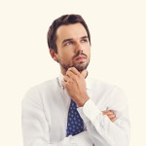
A very professional financial advisor, who is true to his word. John has demonstrated a high amount of integrity in the time I have known him, and he is fast to respond to my concerns. I feel that John is genuinely putting my financial gains before his own, a quality that comforts me in my investments.
It is not every day that you come across a passionate and trustworthy financial advisor. John has encompassed that really well and has provided us with the helping hand to dream that much more and make that dream a possible reality. Thanks John!
In just 2 very short meetings with John he managed to find the solution personally catered to my situation and expectations. Punctual, well informed and very reliable.
Director of "Financial Times“
Johnson.M.J.
Director of "Financial Times“
Johnson.M.J.
Director of "Financial Times“
Johnson.M.J.

Slide 6
Director of "Financial Times“
Johnson.M.J.
30%
50%
80%
2014年
2015年
2016年
Director of "Financial Times“
Johnson.M.J.
Director of "Financial Times“
Johnson.M.J.
Director of "Financial Times“
Johnson.M.J.
In just 2 very short meetings with John Punctual
In just 2 very short meetings with John Punctual
In just 2 very short meetings with John Punctual

Slide 7
Part 2

Slide 8
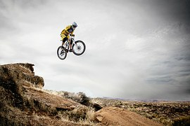
Director of "Financial Times“
Johnson.M.J.
In just 2 very short meetings with John he managed to find the solution personally catered to my situation and expectations. Punctual, well informed and very reliable.

Slide 9
In just 2 very short meetings with John he managed to find the solution personally catered to my
MOSCOW
PARIS
PEIKING
In just 2 very short meetings with John he managed to find the solution personally catered to my
WASHINGTON
In just 2 very short meetings with John he managed to find the solution personally catered to my
In just 2 very short meetings with John he managed to find the solution personally catered to my

Slide 10
Director of "Financial Times“
Johnson.M.J.
In just 2 very short meetings with John Punctual
Director of "Financial Times“
Johnson.M.J.
In just 2 very short meetings with John Punctual

Slide 11
Part 3

Slide 12
Director of "Financial Times“
Johnson.M.J.
In just 2 very short meetings with John he managed to find the solution personally catered to my situation and expectations. Punctual, well informed and very reliable.
Notes:
版权声明：300套精品模板商业授权，请联系【锐旗设计】:https://9ppt.taobao.com，专业PPT老师为你解决所有PPT问题！

Slide 13
OUR CHASING
In just 2 very short meetings with John he managed to find the solution personally catered to my
6%
29%
65%
PART ONE
PART TEO
PART THREE

Slide 14
Part 4

Slide 15
Director of "Financial Times“
Johnson.M.J.
Director of "Financial Times“
Johnson.M.J.
Director of "Financial Times“
Johnson.M.J.
OUR CHASING
In just 2 very short meetings with John he managed to find the solution personally catered to my situation and expectations.
In just 2 very short meetings with John he managed to find the solution personally catered to my situation and expectations.
In just 2 very short meetings with John he managed to find the solution personally catered to my situation and expectations.
In just 2 very short meetings with John he managed to find the solution personally catered to my
In just 2 very short meetings with John he managed to find the solution personally catered to my

Slide 16
OUR CHASING
PROFESSIONALS
86%
51%
Director of "Financial Times“
Johnson.M.J.
In just 2 very short meetings with John Punctual
Director of
"Financial Times“
Johnson.M.J.
In just 2 very short meetings with John Punctual

Slide 17
THANK
YOU.
Notes:
版权声明：300套精品模板商业授权，请联系【锐旗设计】:https://9ppt.taobao.com，专业PPT老师为你解决所有PPT问题！

